Slide 1
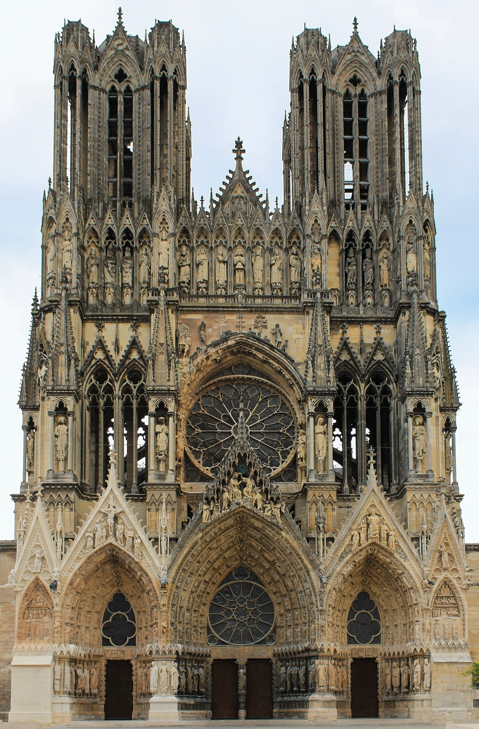
Reims Cathedral, Reims, France, ca. 1225-1290.
4 architects
multigeneration construction campaign
prestige
French kings’ coronations
lancets
stained-glass rose window
Intricately framed voids replace heavy masonry.

Slide 2
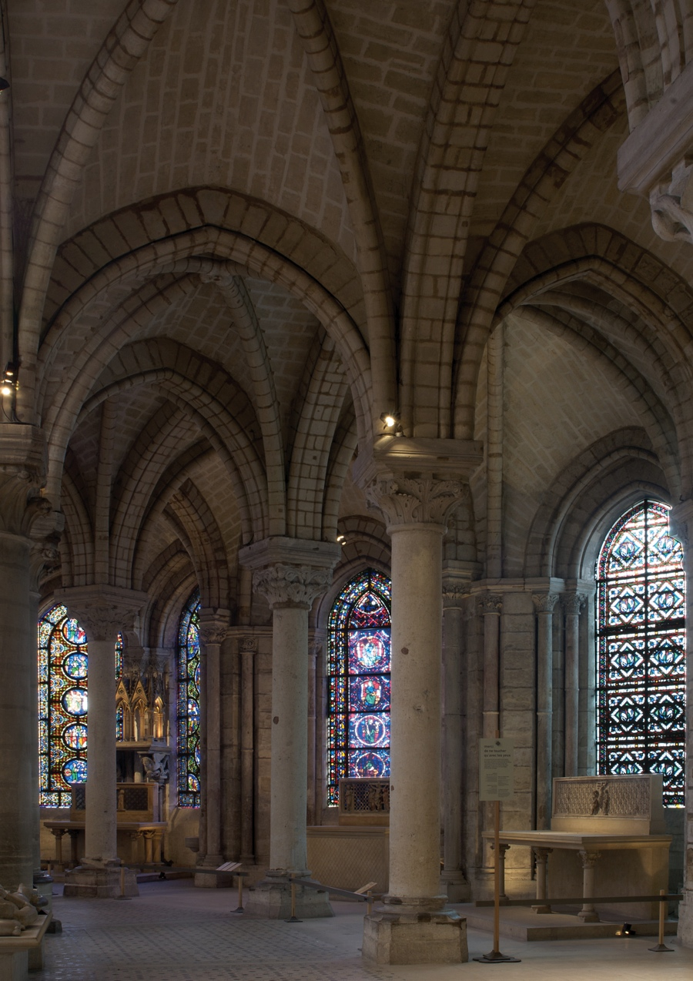
Ambulatory and radiating chapels, abbey church, Saint-Denis, France, 1140-1144.

Slide 3
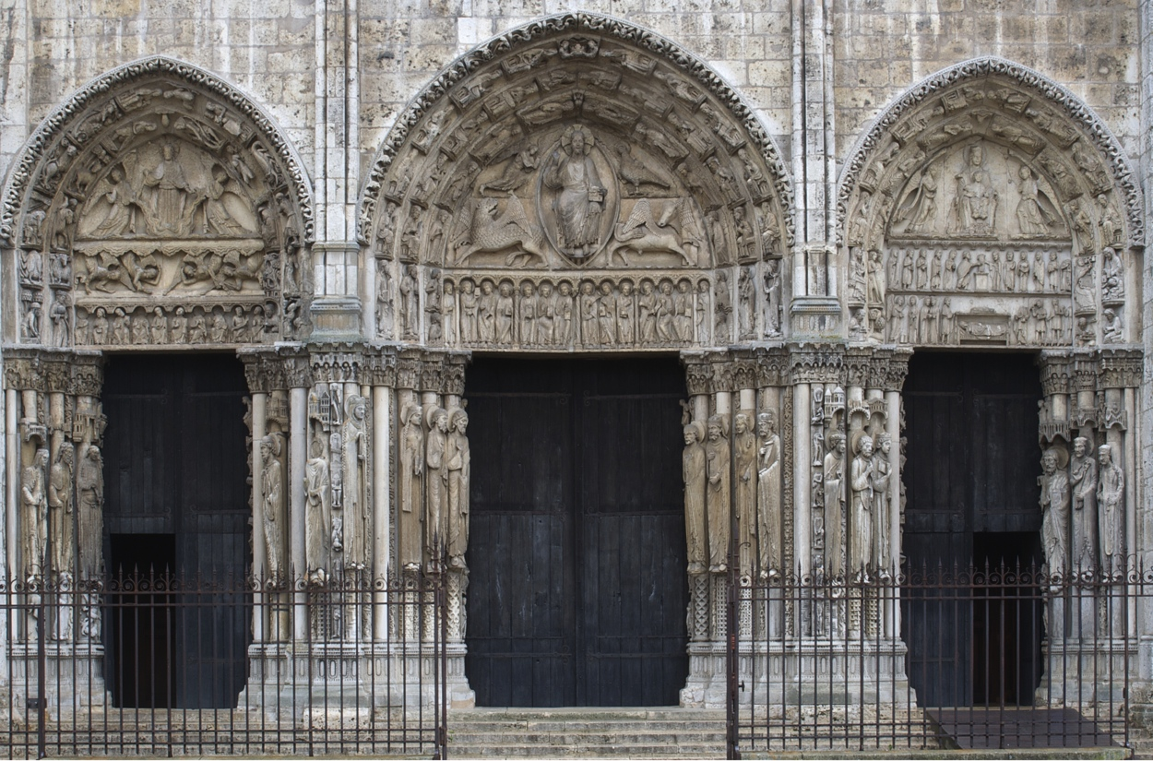
Royal Portal, west facade, Chartres Cathedral, Chartres, France, ca. 1145-1155.

Slide 4
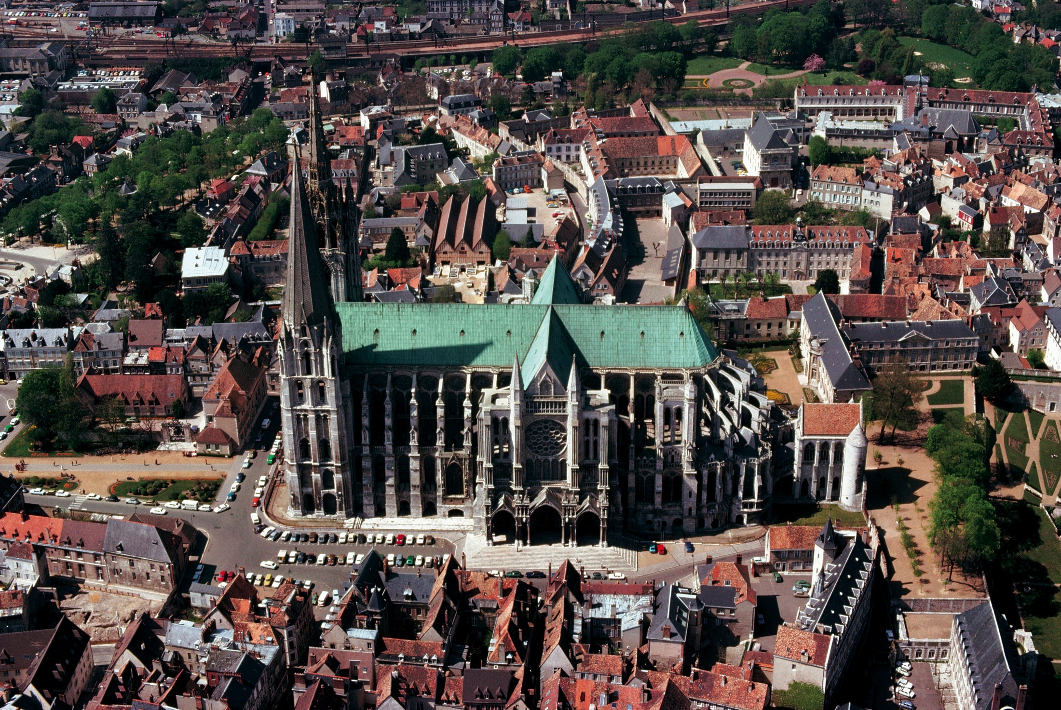
Aerial view of Chartres Cathedral (looking north), Chartres, France, as rebuilt after 1194.
27 years
At one point the townspeople revolted against the prospect of a heavier tax burden.
mid-12th-c. west facade + crypt
the mantle of the Virgin
the earliest example of High Gothic building
the first major church planned from the beginning to have flying buttresses
The Chartres windows are almost as tall as the main arcade.

Slide 5
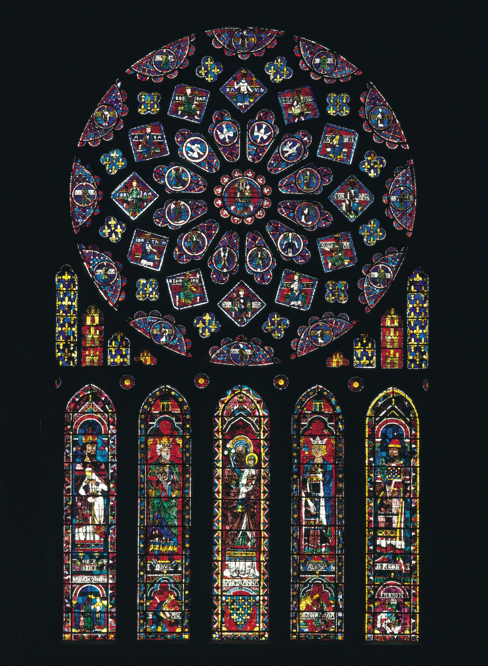
Rose window and lancets, north transept, Chartres Cathedral, Chartres, France, ca. 1220. Stained glass, rose window 43’ in diameter.
Queen Blanche of Castile
the royal motifs of yellow castles on a red ground and yellow fleurs-de-lis
“tree of Jesse”
royal genealogy
Suger’s mystical lux nova
a floating vision of the celestial heavens

Slide 6
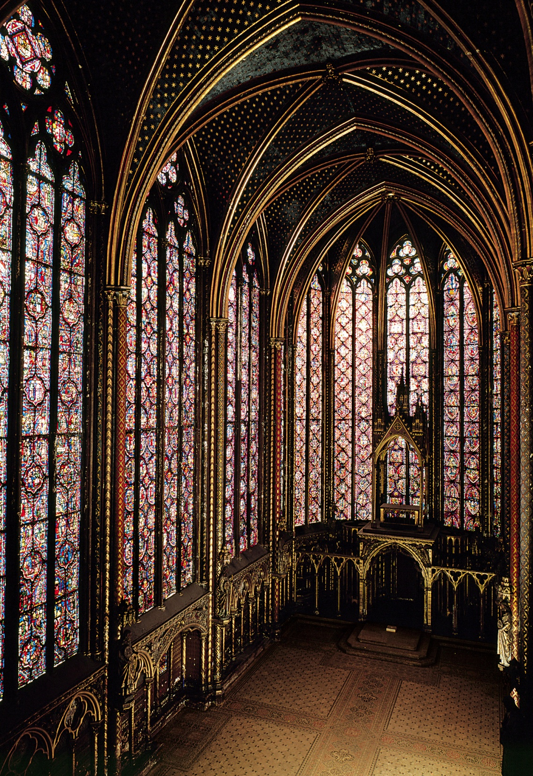
Interior of the upper chapel, Sainte-Chapelle, Paris, France, 1243-1248.

Slide 7
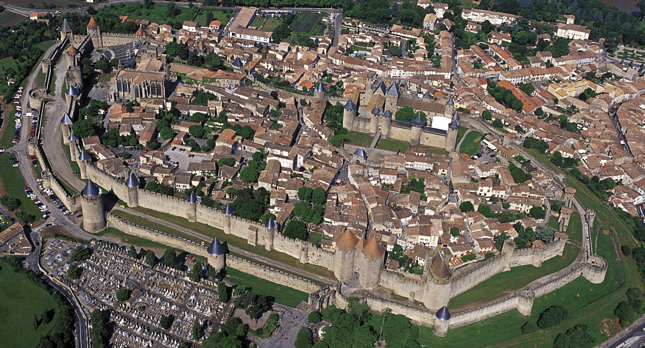
Aerial view of the fortified town of Carcassonne, France. Bastions and towers, 12t-13th centuries, restored by Eugène Viollet-le-Duc in the 19th century.
once the regional center of resistance to the northern forces of royal France
the best-preserved example of a Gothic fortified town
fortified since the Roman times
Visigothic walls dating from the 6th c., reinforced in the 12th c.
battlements with crenellations
a tightly contained complex of castle, cathedral, and town within towered walls

Slide 8
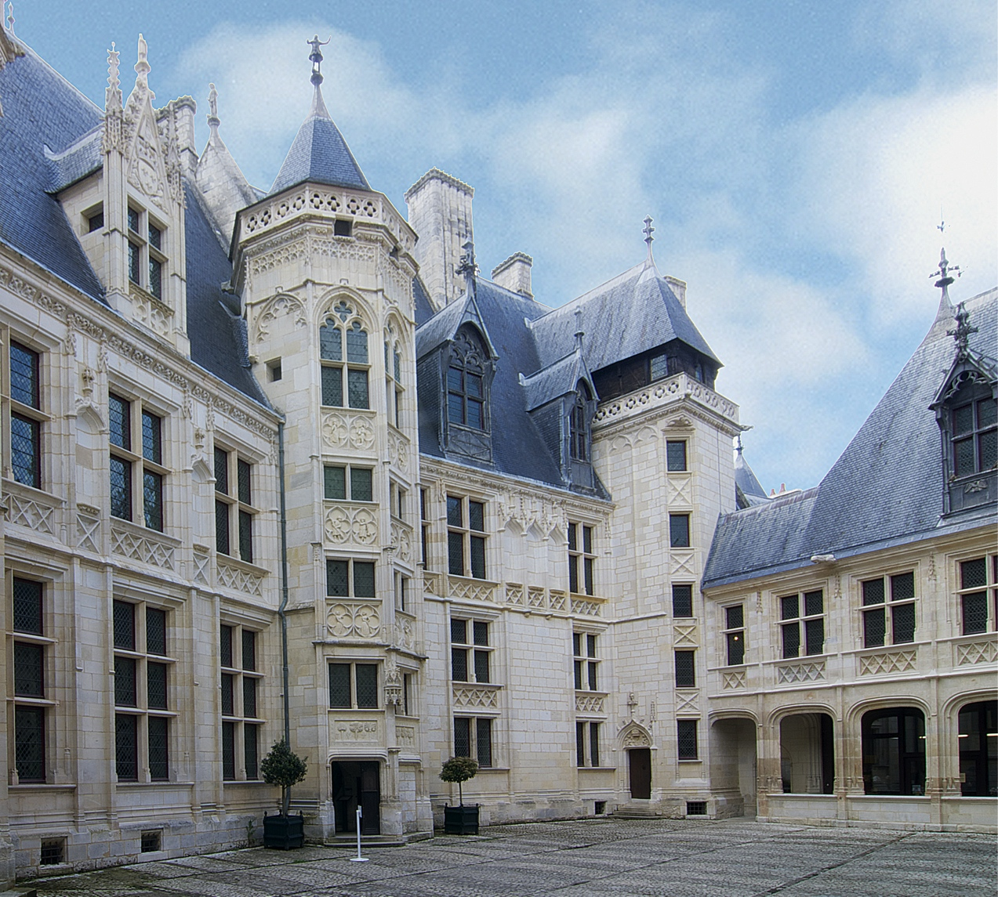
House of Jacques Coeur, Bourges, France, 1443-1451.

Slide 9
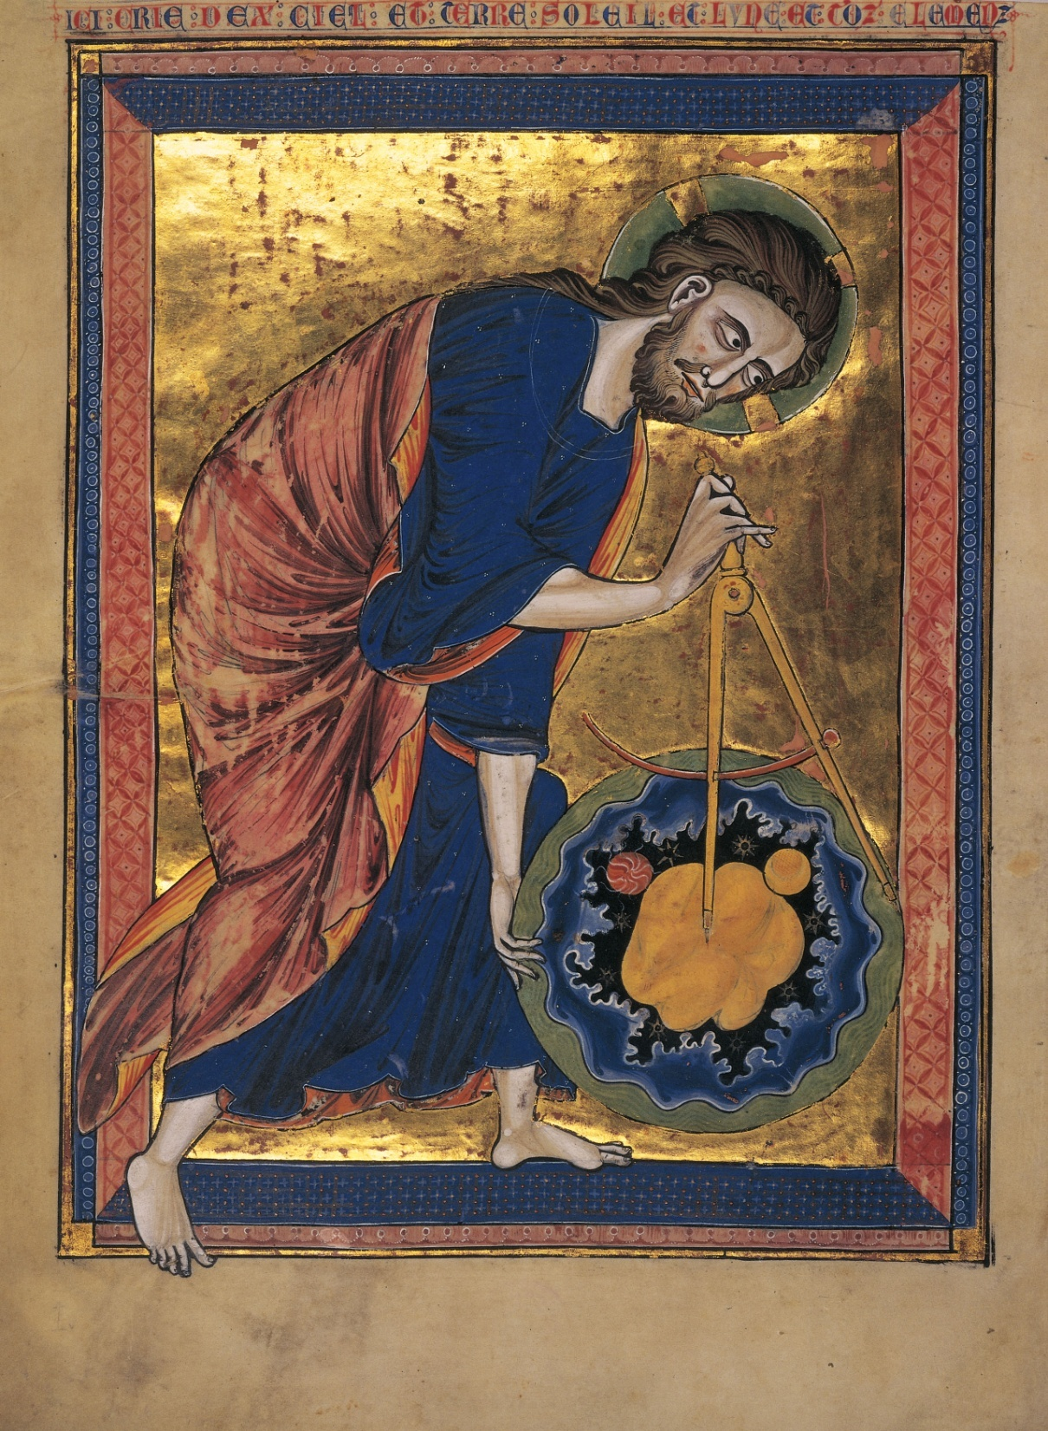
God as Creator of the World, folio 1 verso of a moralized Bible, from Paris, France, ca. 1220-1230. Ink, tempera, and gold leaf on vellum, 1’ 1 1/2” x 8 1/4”. Osterreichische Nationalbibliothek, Vienna.
“Here God creates heaven and earth, the sun and moon, and all the elements.”
shaping the universe with the aid of a compass
creating the universe using geometrical principles
The circle, which has neither a beginning nor an end, symbolized the eternity of the one God.
Gothic architects based their designs on the art of geometry, building their forms out of abstract shapes laden with symbolic meaning.
working according to the divinely established laws of nature

Slide 10
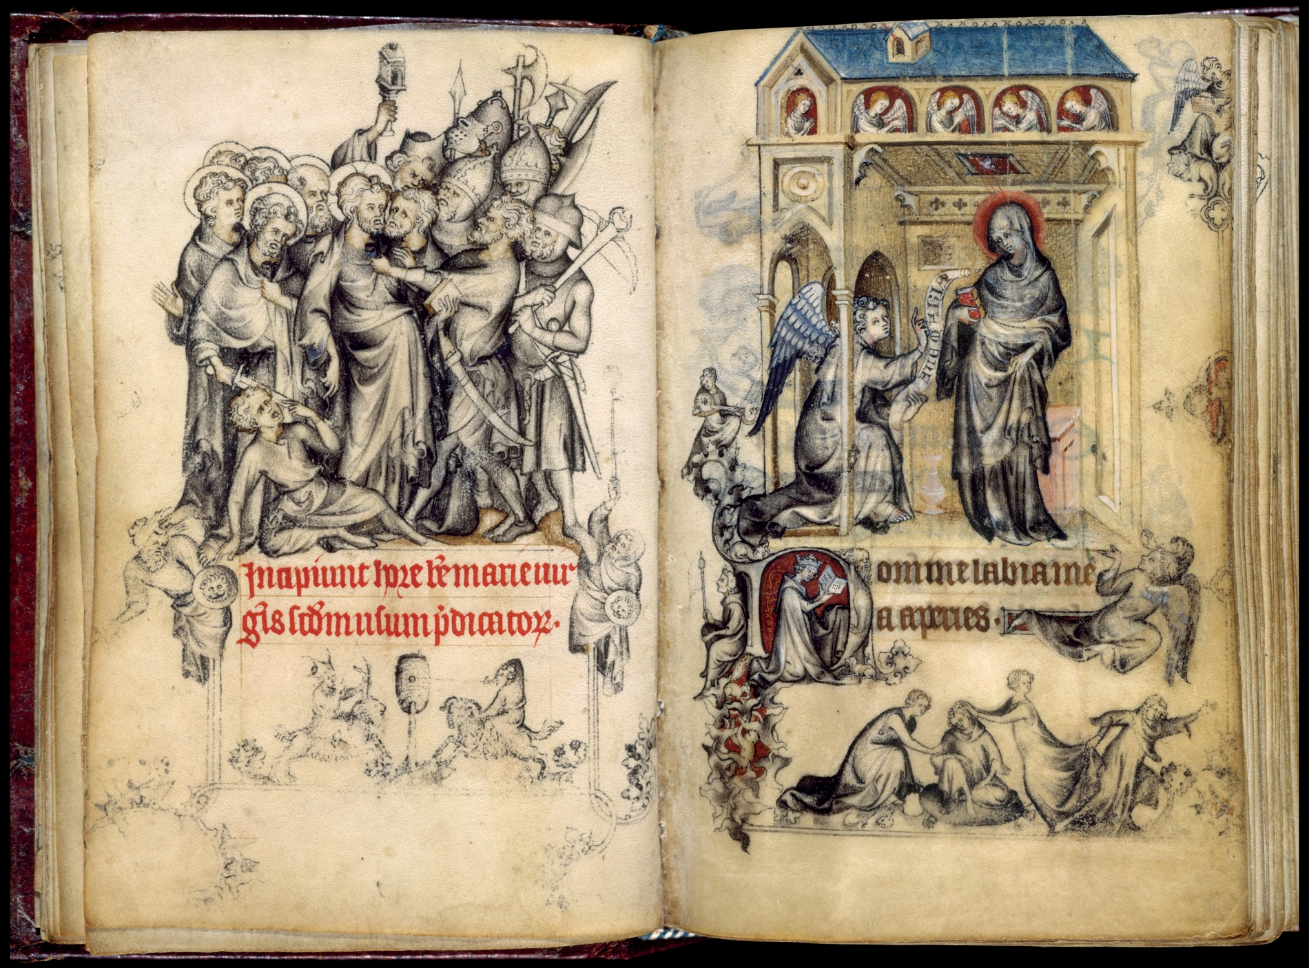
Jean Pucelle, Betrayal of Christ and Annunciation, folios 15 verso and 16 recto of the Hours of Jeanne d’Evreux, from Paris, France, ca. 1325-1328. Ink and tempera on vellum, each page 3 1/2” x 2 1/2”. Metropolitan Museum of Art, New York (Cloisters Collection).
Book of Hours
commissioned from the Parisian artist Pucelle by King Charles IV for his third wife, Jeanne d’Evreux
contains the unusual Hours of Saint Louis, thus reflecting Capetian dynastic devotion on the part of Charles IV and Jeanne d’Evreux, both great-grandchildren of Louis IX
grisaille
Volume and spatial depth are rendered with unprecedented virtuosity in a Northern context, betraying the artist’s knowledge and understanding of Italian painting.

Slide 11
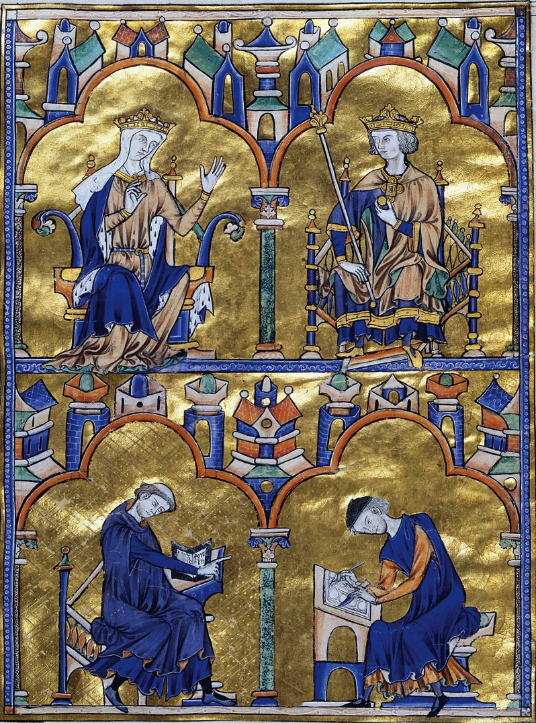
Blanche of Castile, Louis IX, and two monks, dedication page (folio 8 recto) of a moralized Bible, from Paris, France, 1226-1234. Ink, tempera, and gold leaf on vellum, 1’ 3” x 10 1/2”. Pierpont Morgan Library, New York.
a moralized Bible
Blanche of Castile ordered the Morgan Bible during her regency for her teenage son
a monk + a professional lay scribe
from monastic scriptoria to urban workshops of professional artists
Saint Louis was an avid collector of books.

Slide 12
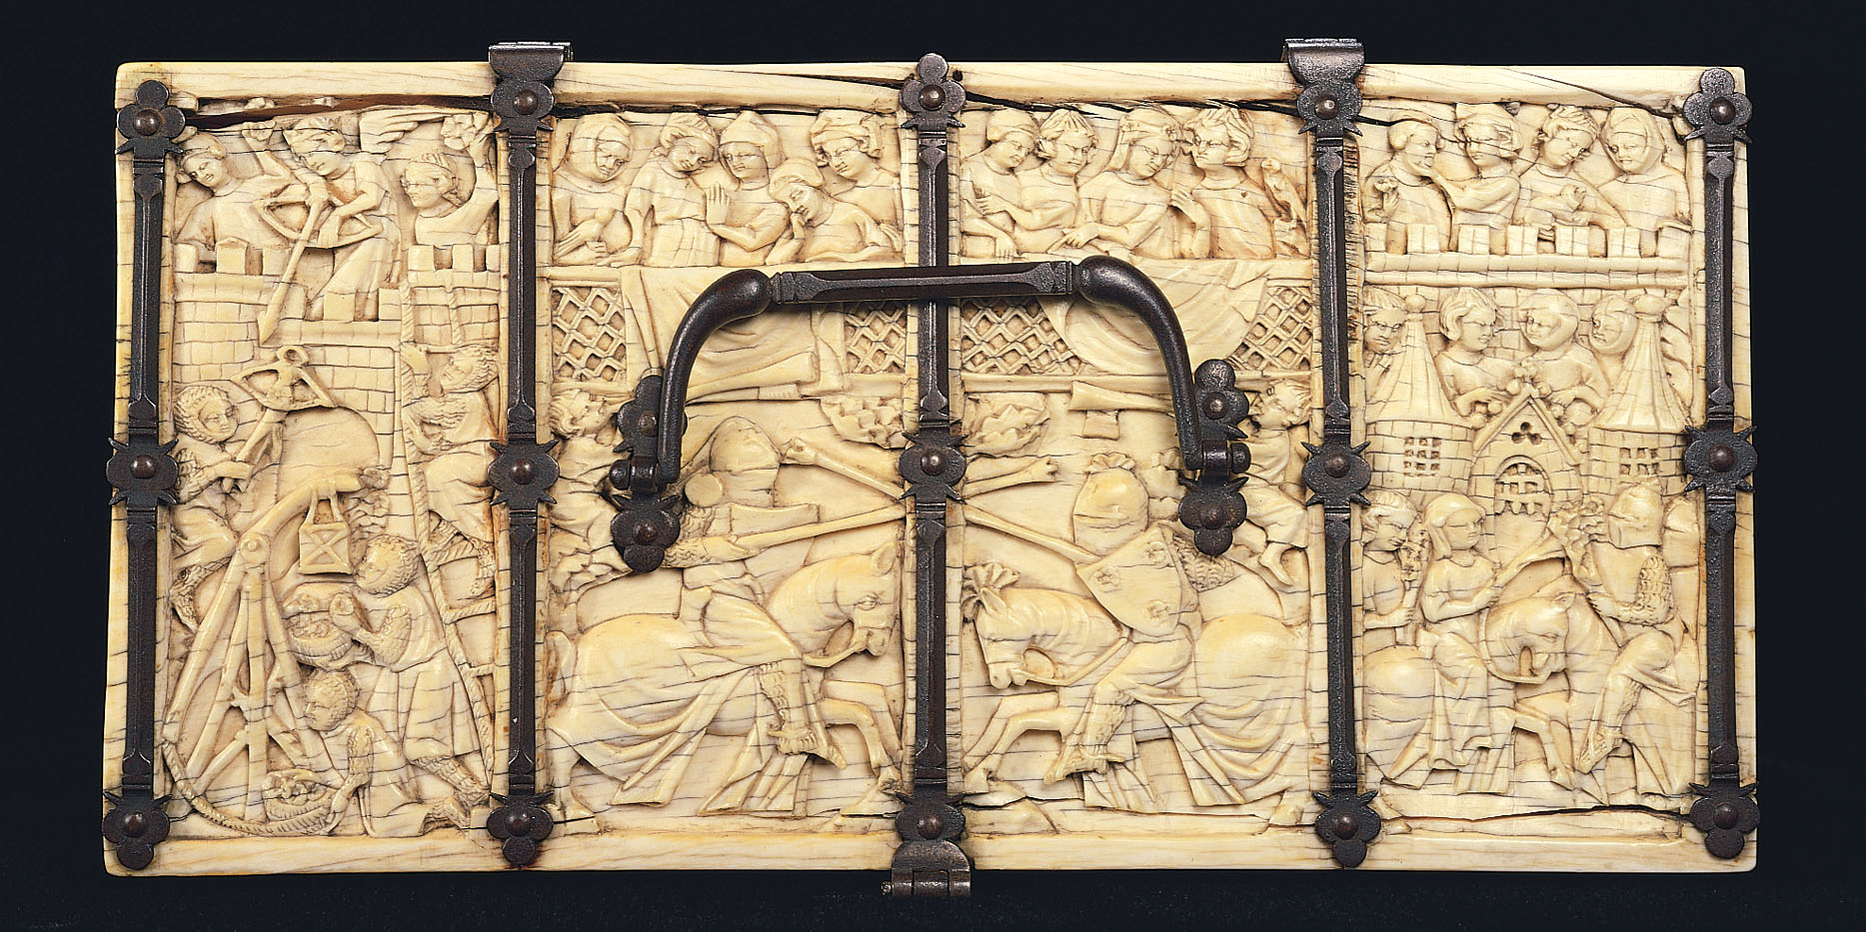
Castle of Love, lid of a jewelry box, from Paris, France, ca. 1330-1350. Ivory and iron, 4 1/2” x 9 3/4”. Walters Art Museum, Baltimore.

Slide 13
Circle of Simone Martini (fl. 1315-47) and Lippo Memmi (c. 1317-47), The Glorification of Saint Thomas Aquinas, ca. 1340-45. Tempera on panel.
Thomas Aquinas (1225-1274), Summa Theologica (Compendium of Theology)
Scholasticism (the Gothic school of philosophy in which scholars applied Aristotle’s system of rational inquiry to the interpretation of religious belief)
Aristotelian philosophy
to prove the existence of God by rational argument
Averroes

Slide 14
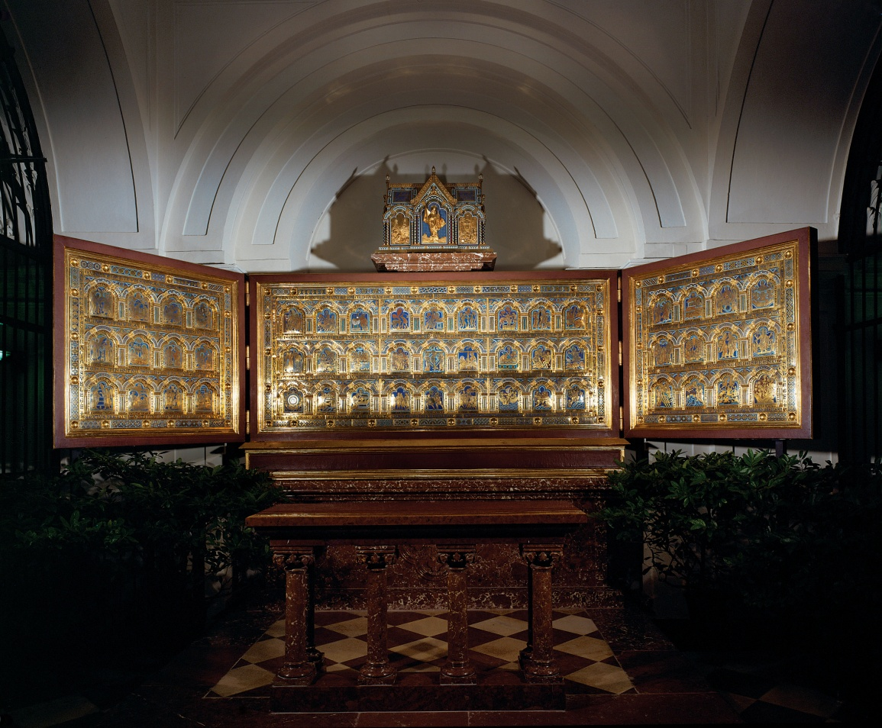
Nicholas of Verdun, general view of the Klosterneuburg Altar, from the abbey church at Klosterneuburg, Austria, 1181; refashioned after 1330. Gilded copper and enamel in wooden frames, 3’ 6 3/4” high. Stiftsmuseum, Klosterneuburg.
the leading Mosan artist of the late 12th and early 13th centuries
a gilded copper and enamel ambo for the Benedictine abbey church at Klosterneuburg
altarpiece
triptych
ante legem + sub gracia + sub lege
Christ’s crucifixion – Abraham’s sacrifice of Isaac

Slide 15
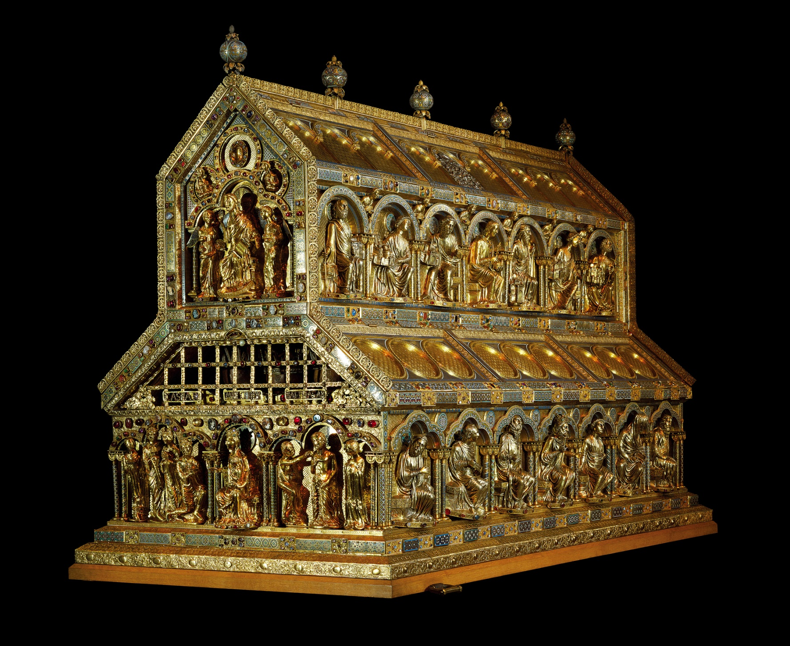
Nicholas of Verdun, Shrine of the Three Kings, from Cologne Cathedral, Cologne, Germany, begun ca. 1190. Silver, bronze, enamel, and gemstones, 5’ 8” x 6’ x 3’ 8”. Cathedral Treasury, Cologne.
reliquary
archbishop of Cologne
Holy Roman Emperor Frederick Barbarossa (r. 1155-1190)
The three kings’ relics gave the archbishop and his successors the right to crown German kings.
a basilican church
imperial patronage of Christianity

Slide 16
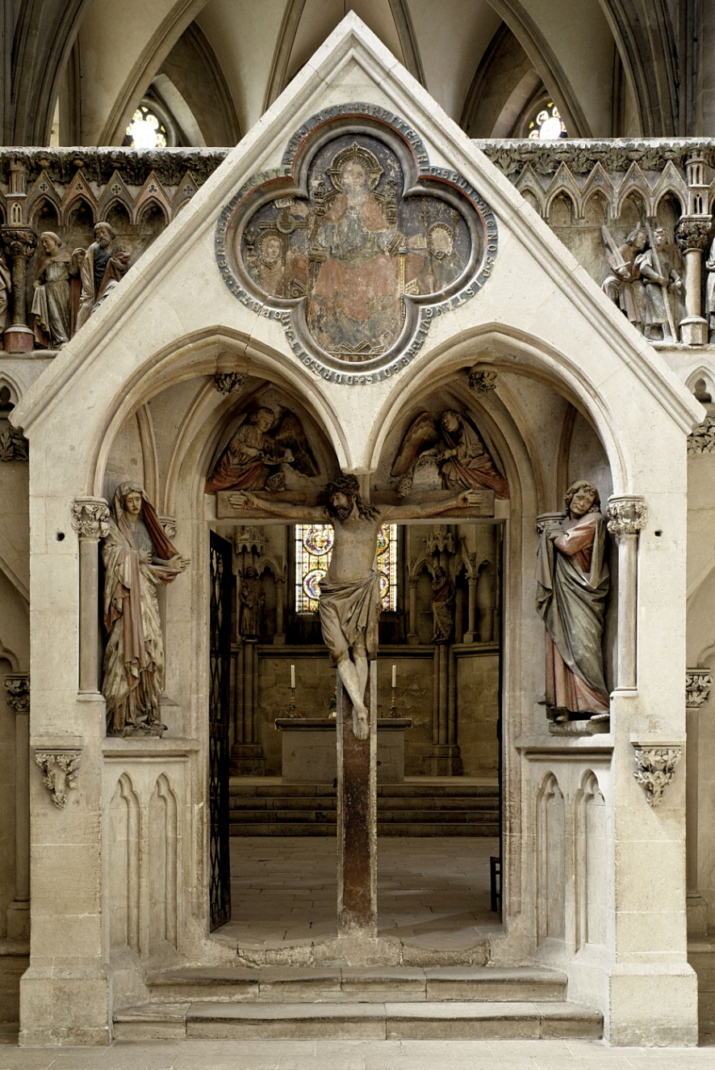
Naumburg Master, Crucifixion, west choir screen of Naumburg Cathedral, Naumburg, Germany, ca. 1249-1255.
a portal to the western choir
life-size figures
bishop
the rebuilding of the Romanesque cathedral at Naumburg
a memorial to 12 donors of the original 11th-c. church

Slide 17
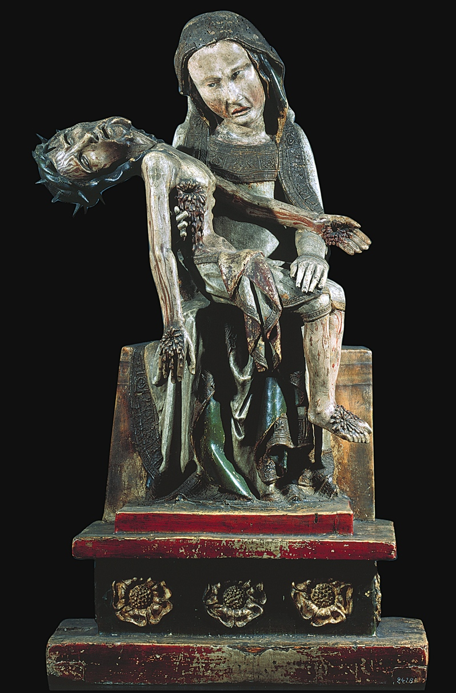
Virgin with the Dead Christ (Röttgen Pietà), from the Rhineland, Germany, ca. 1300-1325. Painted wood, 2’ 10 1/2” high. Rheinisches Landemuseum, Bonn.

Slide 18
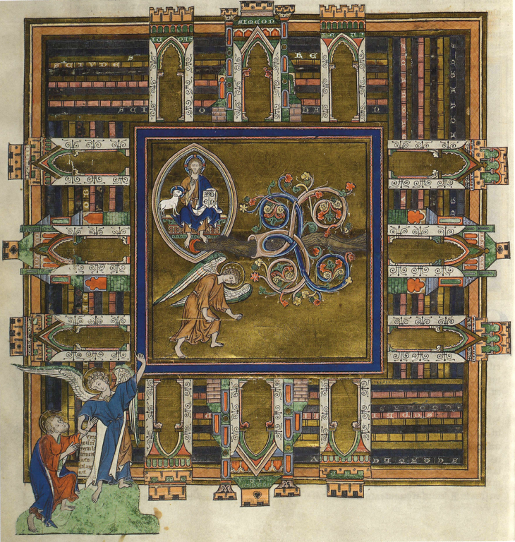
Angel shows John the New Jerusalem. Trinity Apocalypse, ca. 1255-60. Cambridge, Trinity College Library, R.16.2., fol. 25v. Illumination on parchment.
apocalypse manuscript
bird’s eye view of the Heavenly Jerusalem
a walled city in the form of a perfect square with 12 gates
the angel measuring the city
the vision of God set off by a threefold blue and gold frame
the river of life + the tree of life
follows the biblical text in having the angel lead John to a mountain where he sees “the holy city Jerusalem coming down out of heaven from God”

Slide 19
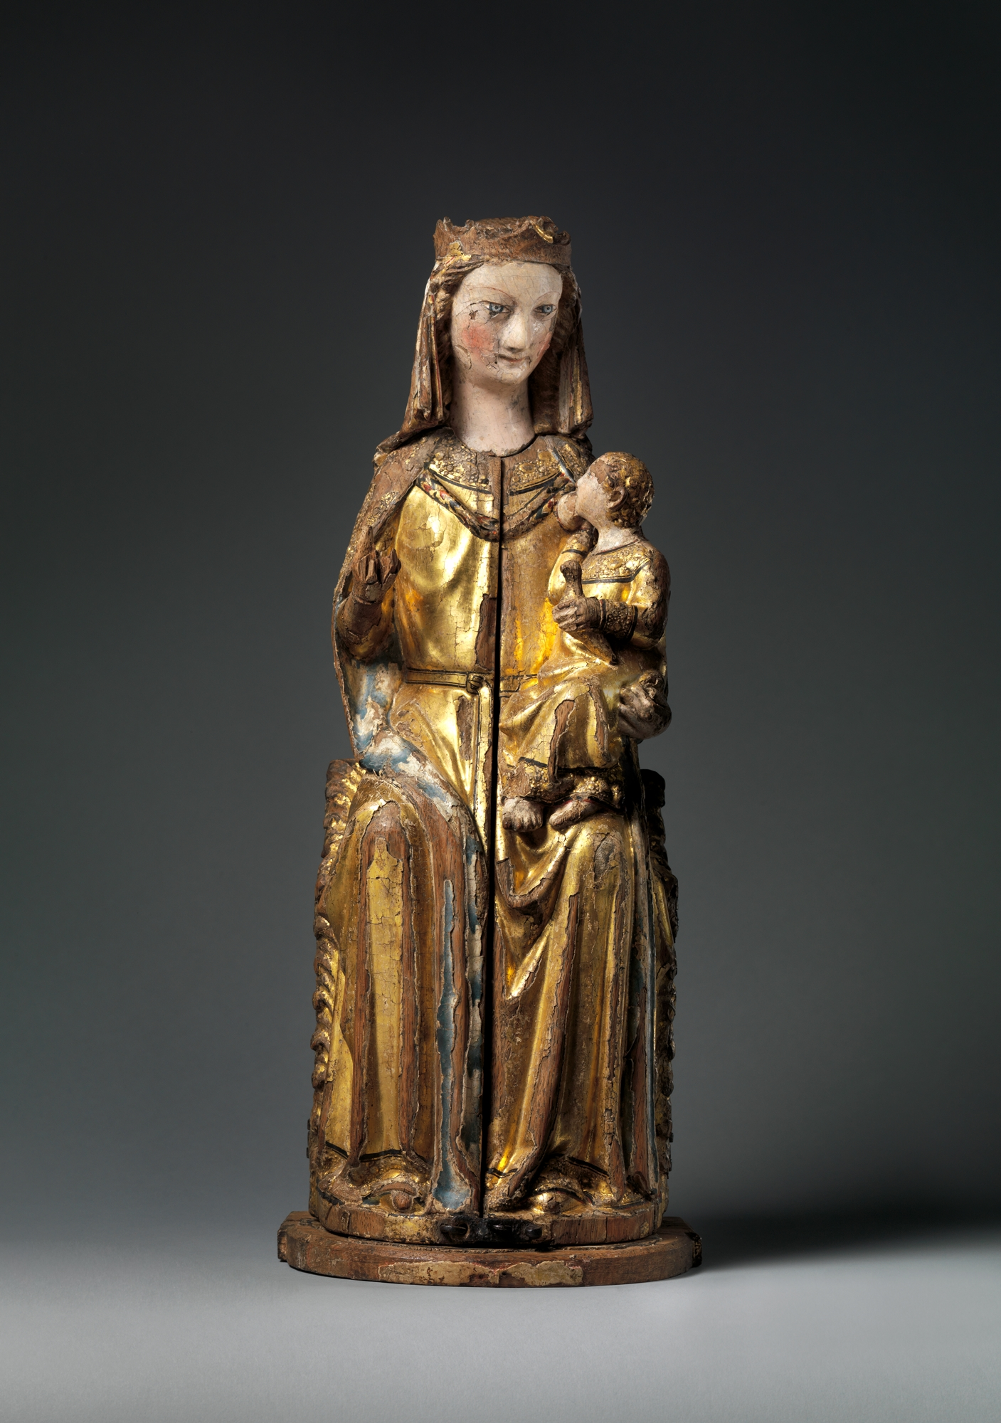
Shrine of the Virgin, ca. 1300, German. Oak, linen covering, polychromy, gilding, gesso.
devotional shrine
manifests Christian belief in the miracle of the Incarnation, by which God took on human body and nature, uniting both human and divine in the person of Jesus
When opened, the shrine is transformed into an altarpiece showing a sculptural representation of the Trinity.
performative

Slide 20
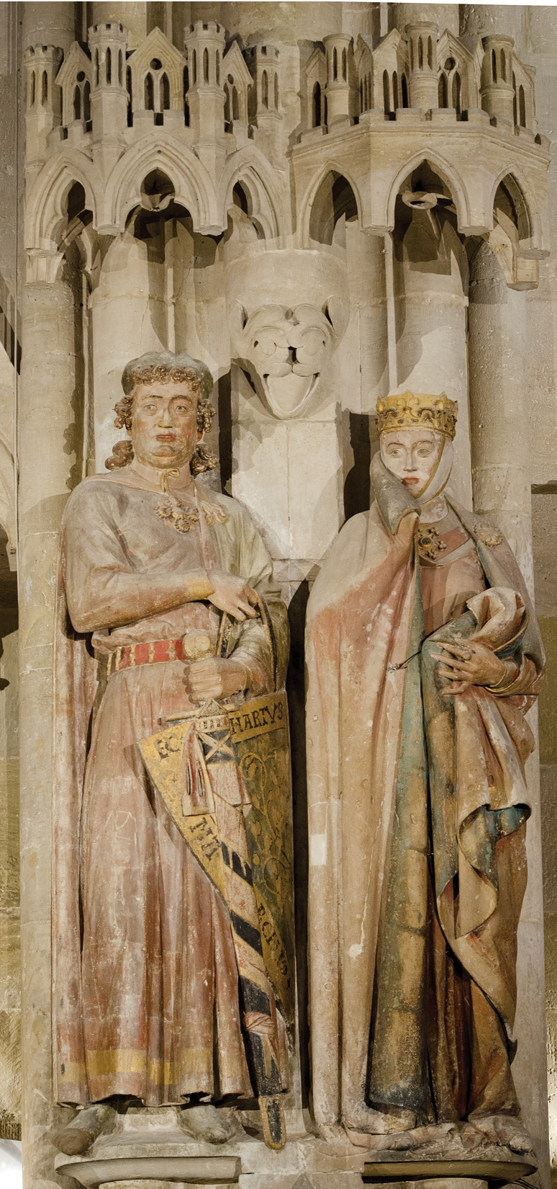
Naumburg Master, Ekkehard and Uta, statues in the west choir, Naumburg Cathedral, Naumburg, Germany, ca. 1249-1255. Painted limestone, Ekkehard 6’ 2” high.

Slide 21
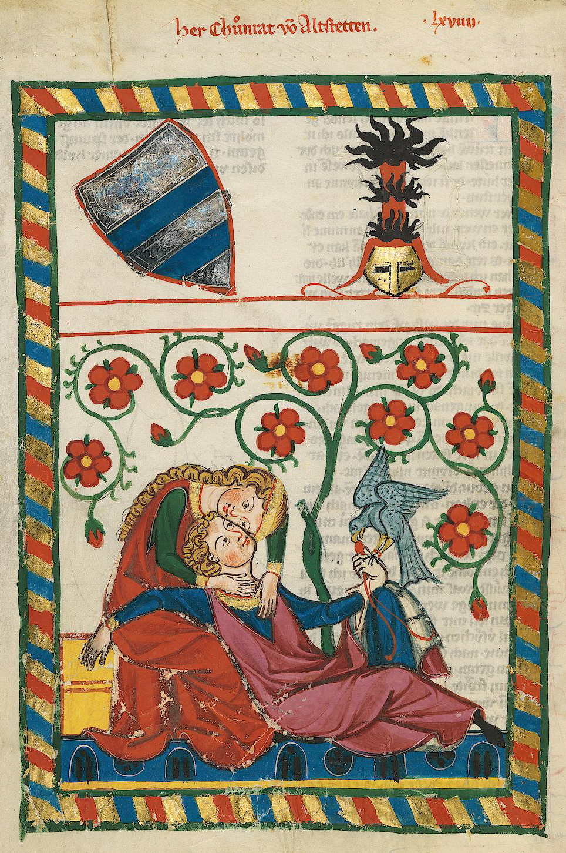
Konrad von Altstetten as hunter and hunted, from the Manesse Codex, Zürich, ca. 1300. Heidelberg, Universitätsbibliothek, Cod. Pal. Germ. 848, fol. 249v.
German love-poets
The bird represents his lady who has her arms around her prey and feeds on him with her kisses.
She is in the dominant spatial position in the image, but, like Konrad’s falcon, she is actually the object of his manipulation.
Training the falcon involved getting the bird first to accept human beings, which involved using a hood to blindfold the creature and calm it and then letting it fly off to hunt, but always tethered by the leash. Progressing slowly, the training of birds took tremendous patience and sensitivity to the creature’s moods on the part of its handler.
courtly love

Slide 22
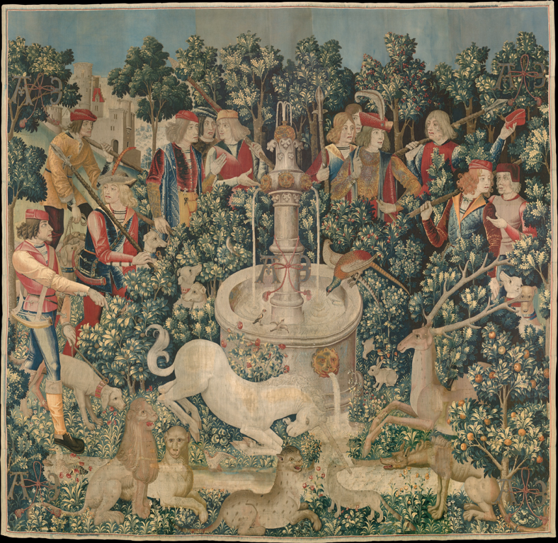
Unicorn Tapestries, ca. 1500, South Netherlandish.

Slide 23
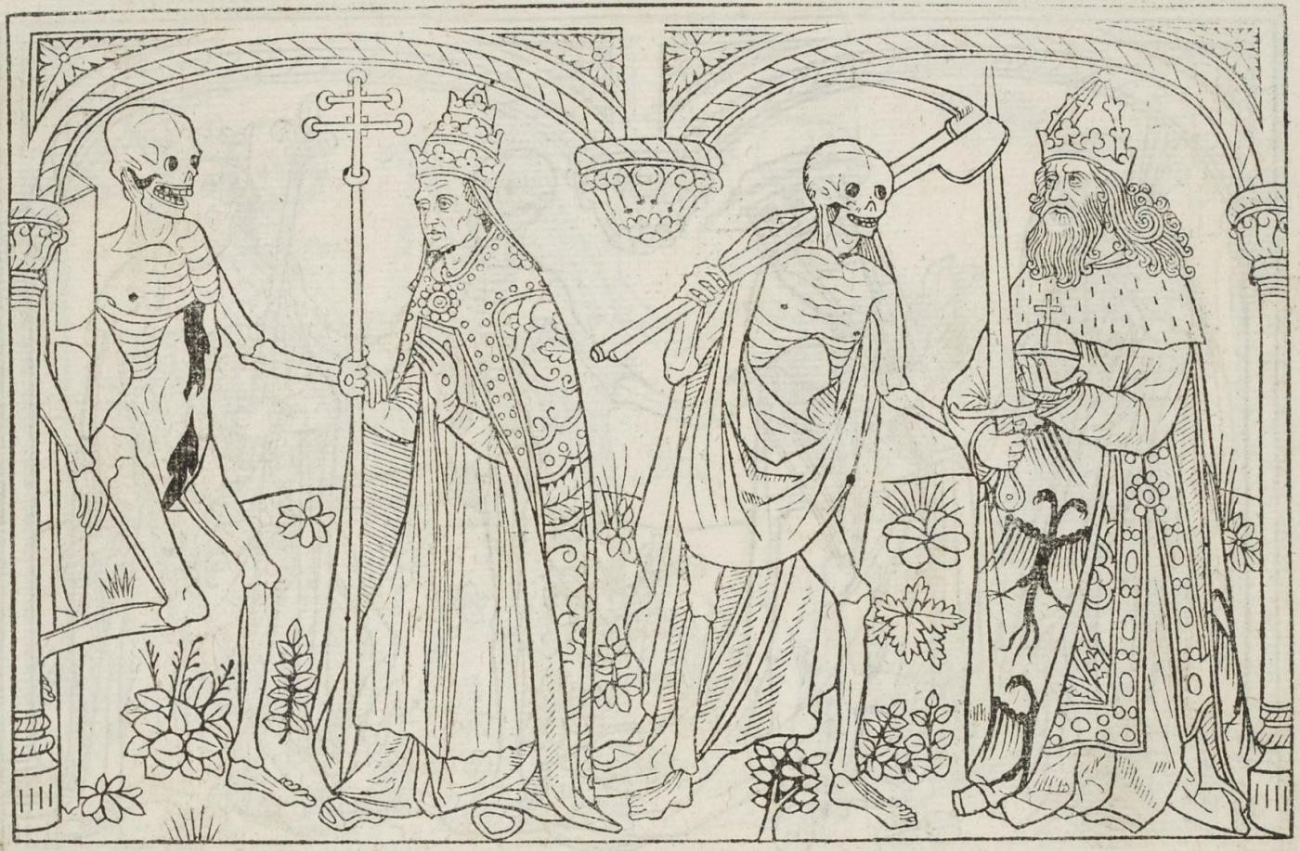
The 1425 Dance of Death from the Cemetery of the Holy Innocents, Paris, as preserved in Guyot Marchant’s woodcut edition of 1490.
a succession of protagonists forced to accept the inevitability of their death and recognize the futility of resisting it
death that inevitably claims all men, but also death that hand-picks each protagonist, identified by his individual attributes and (mis)deeds
the recurrence of the paired, doubled dancers that follow one another
In this morbid procession we encounter a representation that figures death’s oppressive physicality, as skeleton after skeleton parades in front of the viewer, each prancing, displaying its body from every possible angle.
Death is transformed into a spectacle of crumbling flesh that flaunts its own decay and disintegration for the benefit of the viewer.
Death imposes itself upon its victims in strict order, thereby underscoring and reinforcing the very hierarchies it seemingly seeks to undermine.
mocking the vanity of the human condition
macabre
death and life as a continuum

Slide 24
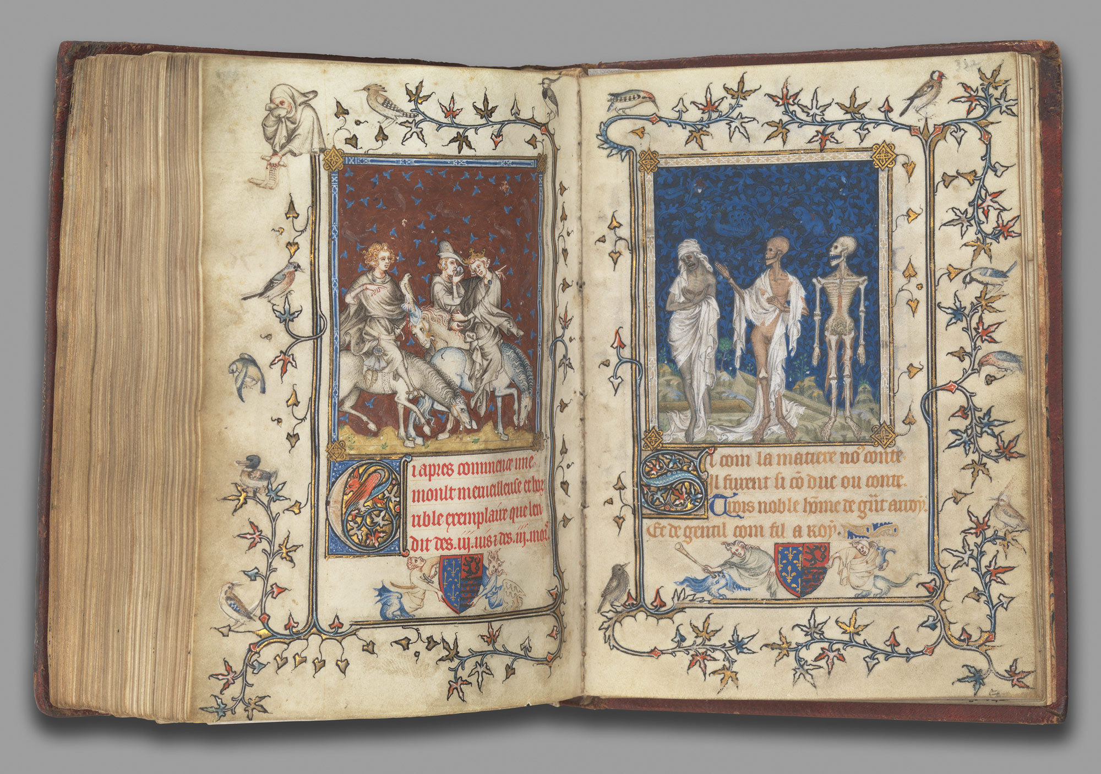
The Prayer Book of Bonne of Luxembourg, Duchess of Normandy, before 1349, attributed to Jean Le Noir.
Encounter of the Three Dead and the Three Living
stems from a poem, originally written in the second half of the thirteenth century, several versions of which exist in French, English, German, Italian, and Latin
three young men, bedecked in their finest, who during a hunt encounter three corpses in various states of decay
In the resulting dialogue between the living and the dead, the living learn about the fleeting quality of life, the sordid nature of the human body, and the necessity of repentance.
died of plague in 1349
“We once were what you are now; you will become what we are now.”

Slide 25
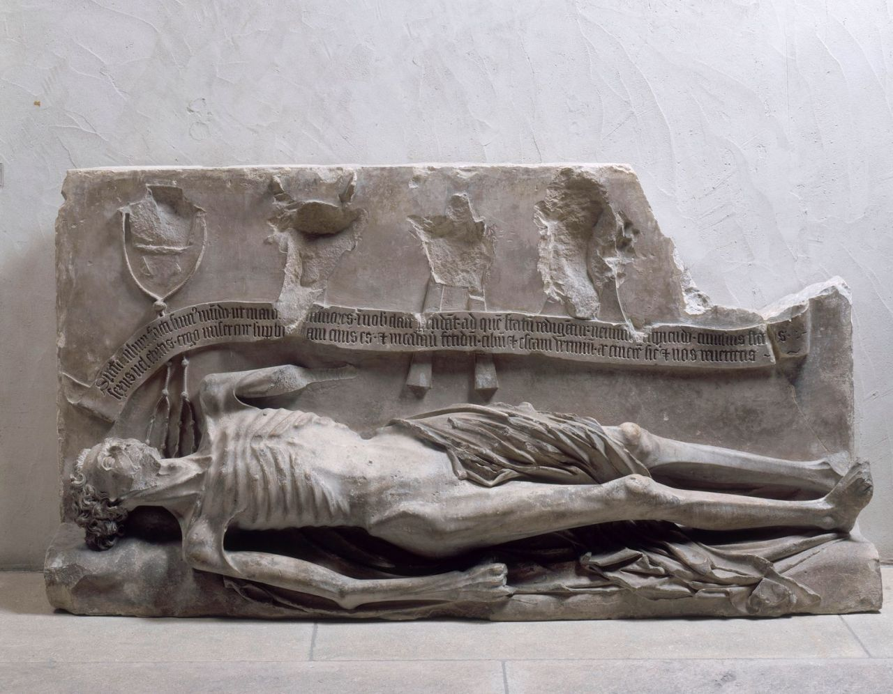
The remnants of the transi tomb of Cardinal Jean de La Grange, ca. 1402, formerly in the church of St Martial, Avignon, now in the Musée du Petit Palais, Avignon.
The image of the deceased carved on a tombstone is doubled by the representation of his decomposed body in a second reclining sculpture underneath.
became popular in the late fourteenth and early fifteenth centuries among the ecclesiastical literati
an almost exclusively northern European phenomenon
Traditionally, medieval effigies drew attention away from contemplation of the dead body within the tomb, but in the late Middle Ages, transi tombs reversed these expectations by exposing the reality of its decay and making it permanent in stone – in effect, putting the corrupt body on display.
inscription

Slide 26
Prompt: The Gothic period of medieval art and architecture is often characterized as a time of economic prosperity, technological innovation, and deep spirituality. Would you agree or disagree with that assessment based on the three works of art and architecture shown below? What do the three works inform us about medieval religion, culture, and society? In your essay, you may identify a common theme (e.g. death and salvation) of the three works and discuss how each work expresses that theme in distinctive ways. Consider the different media, scales, and purposes of each work. Alternatively, you may choose to identify several different themes (e.g. religious architecture, pathos, secular patronage) and demonstrate how those themes are expressed in the individual artworks. Be specific. In addition to considering each work carefully, draw on your knowledge of the Gothic period and different themes we discussed over the course of the semester. You are encouraged to incorporate mentions of source documents and other artworks if you can.
Aerial view of Chartres Cathedral (looking north), Chartres, France, as rebuilt after 1194.
Virgin with the Dead Christ (Röttgen Pietà), from the Rhineland, Germany, ca. 1300-1325. Painted wood, 2’ 10 1/2” high. Rheinisches Landemuseum, Bonn.
The Prayer Book of Bonne of Luxembourg, Duchess of Normandy, before 1349, attributed to Jean Le Noir.

